Slide 1

Tri-NIT Hackathon
HAWKEYE
By:
Amiritavarshini S
Harshini DA
Surya Narayanan CS

Slide 2
Problem Statement :
* Security Agents and operations managers have been tasked with real-time CCTV camera monitoring to detect abnormal behavior or situations in areas under surveillance or for post-event investigation.
* Through the visual surveillance, human activities can be monitored in sensitive and public areas to prevent terrorism, theft, accidents and illegal parking, vandalism, fighting, chain snatching, crime and other suspicious activities.
* They have Needed to review hours or days of footage to extract evidence and Understand what occurred at the time of the incident.

Slide 3
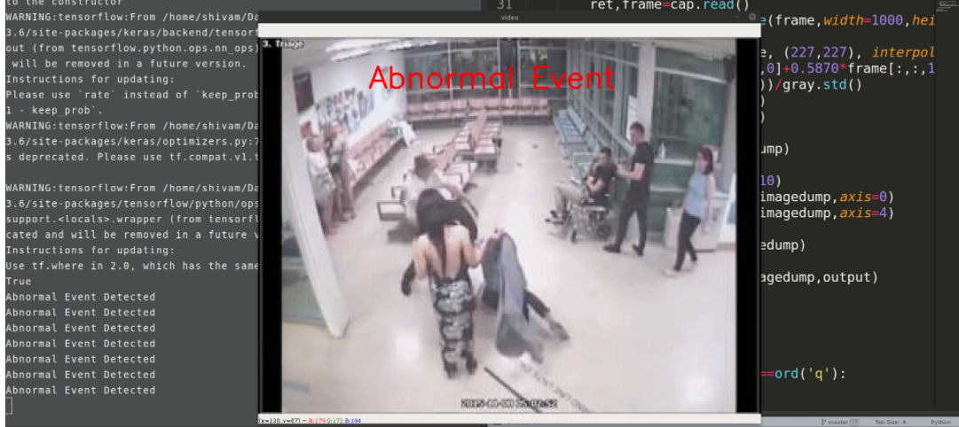
Solution:
Our solution is to achieve the detection of abnormal activities using video metadata and machine learning to build an app “Hawkeye” for real-time alerts, triggering real-time notifications to action when certain objects or behaviors are detected or when anomalous activity occurs.
The app which has been designed by our team shows notification which includes location, cam id and a video clip of violence which has been detected by CCTV camera.

Slide 4
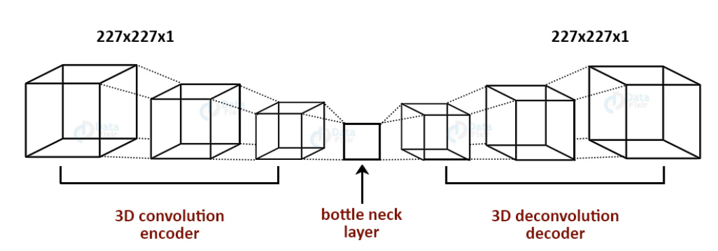
Working:
In this project, we have to extend deep neural networks to 3-dimensional for learning spatio-temporal features of the video feed.
For this video surveillance project, we will introduce a spatio-temporal autoencoder, which is based on a 3D convolution network. The encoder part extracts the spatial and temporal information, and then the decoder reconstructs the frames. The abnormal events are identified by computer.
We train an autoencoder for abnormal event detection.

Slide 5
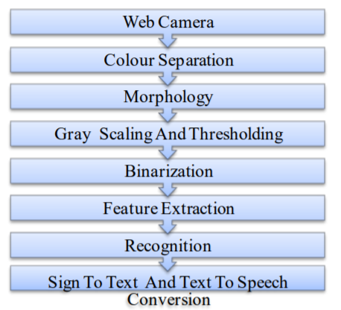
Methodology:
Pre-Processing:
To avoid overworking the inference engine, the pretrained MobileNet model (from the Intel OpenVINO Model Zoo) is used to detect persons in a given frame
Violence Detection:
Each 16 frame sequence is passed throught the trained 3D CNN model which outputs whether the scene is violent or not as probability scores. The class with maximum output is the predicted value.
Visualization:
A front-end interface allows the operation of the system to be viewed in real-time. The video frame is played on-screen with an indicator area that flags violent scenes.
Alert:
When violence is detected in any of the scenes, nearest security group is notified for immediate response.

Slide 6

Working Prototype
GIT LINK :
YOUTUBE LINK :
Your security is our highest priority
SCREENSHOT OF OUR PROPOSED SOLUTION

Slide 7
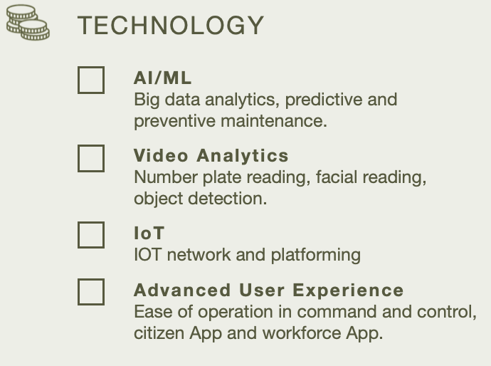
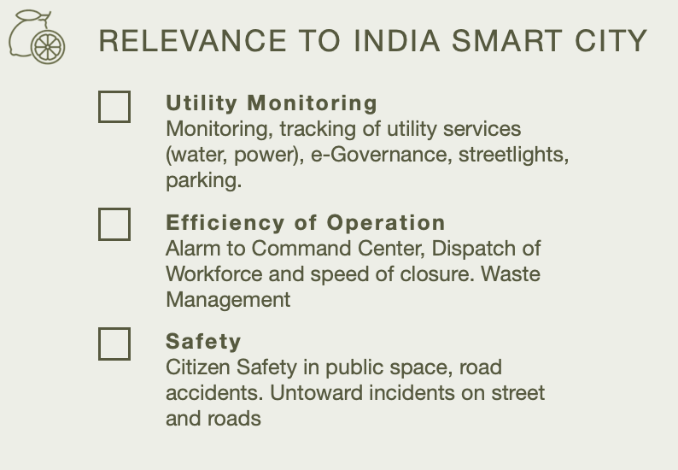

Government Criteria

Slide 8
CONCLUSION:
Machine learning has not only changed the way surveillance video is viewed, but also the ways it can be leveraged for increasing security and operational efficiency.
It reduces the need for humans to monitor every video surveillance feed and recorded video footage, and it allows security personnel to respond to situations, review footage, and uncover trends so that they can utilize video footage more effectively.

